Slide 1
Scheduler Activations: Effective Kernel Support for the User-Level Management of Parallelism
Yen-Hsing Li
Philip Martin

Slide 2
Problems
Threads can be supported either at user level or in the kernel. Neither approach has been fully satisfactory.
User level threads:
++ good performance, flexible.
-- blocking all threads in a process if block system call occurs.
Kernel level threads:
--worse performance
++only block a thread in a process if block system call occurs.

Slide 3
Goals and Approaches
Goal of this work:
Design a kernel interface and a user-level thread package.
Combine the functionality of kernel threads with performance and flexibility of user-level threads.
Approaches:
provide each application with a virtual multiprocessor.
Allow coordination between user and kernel schedulers

Slide 4
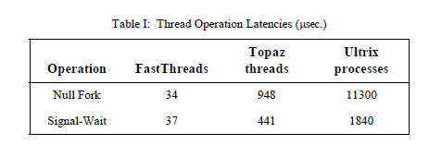
Performance Comparison
User-level
Threads
Kernel
Threads

Slide 5
Virtual Processor Design
kernel controls the allocation of processors to each address space.
user-level thread system controls which threads to run on its allocated processors.
The kernel notifies the user-level thread system whenever the kernel changes the number of processors assigned to it.
The user-level thread system notifies the kernel when the application needs more or fewer processors.

Slide 6
Scheduler Activations
Role
Running user-level threads, in exactly the same way that a kernel thread does.
It notifies the user-level thread system of a kernel event. -> Upcalls
Provide space in kernel to save context of user thread when kernel stops it.

Slide 7
Kernel Upcall Points
After kernel creates a scheduler activation, kernel upcalls into the application address space at a fixed entry point.
New processor available -> Run time picks user thread to use it
Activation blocked ->Runtime runs a different thread on the activation
Activation unblocked
Activation lost processor ->Context remapped to another activation

Slide 8
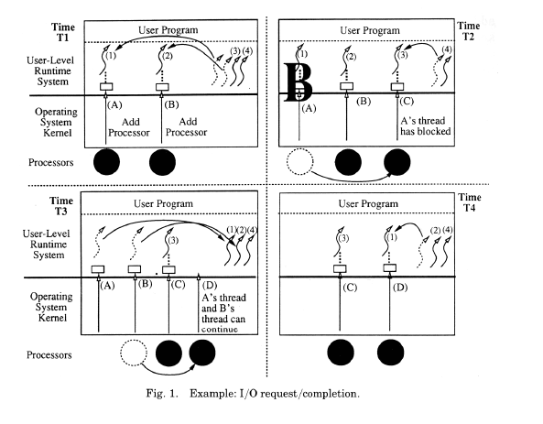
Scheduler Activation example

Slide 9
Critical Sections
User-level thread could be executing in a critical section at the instant when it is blocked or preempted. This may lead to:
Poor performance
Deadlock
Continues the user thread using a user level context switch until the lock is released.

Slide 10
Implementation in Topaz
All features discussed were implemented on the DEC SRC Firefly by modifying the Topaz OS.
Code required was ~1/4 the size of the original OS.
Majority related to processor allocation by the kernel
All equal-priority processes share available processors evenly, including with processes that use standard kernel-level threading

Slide 11
Performance Enhancements
Idle cores “spin” for a brief time before notifying kernel for reallocation
Kernel keeps a copy of all critical sections
Use this instead when pre-empted inside a real one
Return control to activation when done
Avoids additional overhead for regular use of critical sections
Recycle activation data structures from old activations

Slide 12
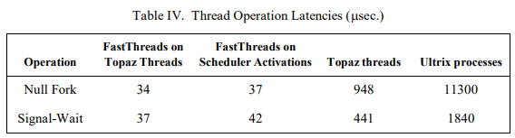
Performance (User-Level)
User-level threading is nearly as fast as before when the kernel isn’t involved
Old User-Level Threads
Modified User-Level Threads

Slide 13
Performance (Kernel-Level)
Kernel operations were ~5x slower than standard
This means slower I/O, page fault, etc.
Implementation likely to blame
Excessive kernel state maintenance
Weaker assembler optimization
Could be comparable to standard Topaz with better optimization

Slide 14
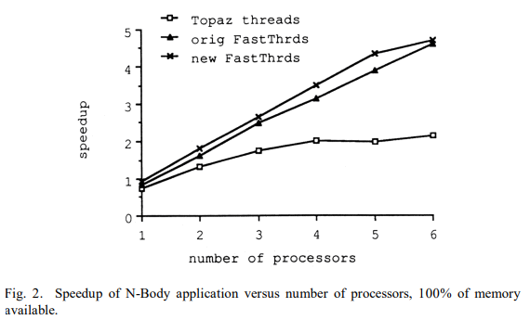
Performance (Practical)
The new thread system outperformed both old systems on a problem that fits in memory
Kernel-level threading was much slower due to trapping overhead on locks

Slide 15
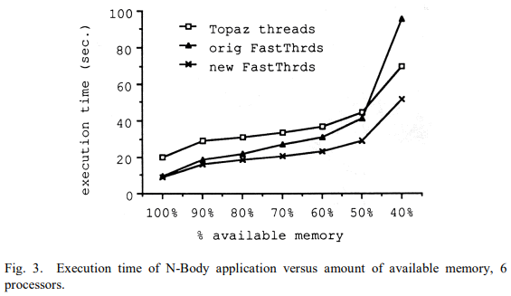
Performance (Practical) cont’d
Performance was also better on a program that requires I/O.
Kernel-level threading has more overhead while User-level threading blocks threads that should be running

Slide 16
Related Ideas
Asynchronous I/O also allows user-level threads to wait without trapping in the kernel.
However, this is much less general and requires developers to use a new interface
Other similar systems fail to implement key optimizations
Psyche, Symunix

Slide 17
Summary
User-Level threads are agile but can block each other when one traps in the kernel
Kernel-Level threads are robust but have high overhead
The new activation-based threading system combines both advantages
Processes manage their own processors and scheduling efficiently
Kernel events that affect the process send notifications, preventing unnecessary blocking
Major performance improvements can be seen in a range of applications

